Slide 1

Duplication of NCDs Data and Its Effect, a case of Kirinyaga County
Presented by Simon Kariuki CNCDC

Slide 2
Presentation outline
Background
Objectives of the audit
Methodology
Findings
Implications
Recommendations
Conclusions
Acknowledgments
Pictorials

Slide 3
Background
The ministry of health introduced MOH 270(permanent register) &MOH 222 (daily activity register) in 2019.
The MOH 270 is supposed to capture all new diabetic, hypertensive or co-morbid clients once in their lifetime. (Subsequent visits are captured in MOH 222.)
All health facilities offering MOPC to DM,HTN and co-morbid clients ought to maintain a permanent register for these clients.
Ideally a client should only be captured in one register in the county and country.
Registering clients more than once inflate disease burden and lead to inaccurate data.

Slide 4
Objectives of the audit
Assess the level of client duplication in MOH 270 across the county
Identify possible causes of duplication
Recommend corrective and preventive measures

Slide 5
Methodology
Data from 45 health facilities offering NCD services ( DM,HTN or both) was line listed on a spreadsheet.
Unique identifiers used were name, age, phone number and residence.
All the 45 health facilities lists were complied into one with a total of 11,414 clients.
The list was subjected to excel filters to identify duplicated unique identifiers.
Duplicated identifiers were further analyzed to arrive at the final duplication %

Slide 6
Findings
Duplication rate: 20% of clients were found to have registered more than once with 1.5% having registered a record 4 times.
Main probable causes:
Lack of universally accepted unique identifier across all facilities.
Stockout of NCDs drugs forcing clients to hop in different facilities looking for the same.
Manual record-keeping system unable to detect multiple registrations
Clients posing as new to re-confirm their diagnosis.

Slide 7
Implications
Inflated NCD burden statistics
Misguided planning & funding
Challenges in continuity of care
Loss of credible NCD data for decision making

Slide 8
Recommendations
Standardize data entry practices
Implement digital health information systems with ability to share client data across the country.
Conduct regular data quality audits
Capacity build staffs

Slide 9
Conclusions
Data integrity is central to NCD program success
Addressing duplication is urgent and actionable
County to adopt audit recommendations for improved data governance

Slide 10
Acknowledgments
The county department of health leadership for the support
The sub county NCDs coordinators
The 45 health facilities in-charges

Slide 11
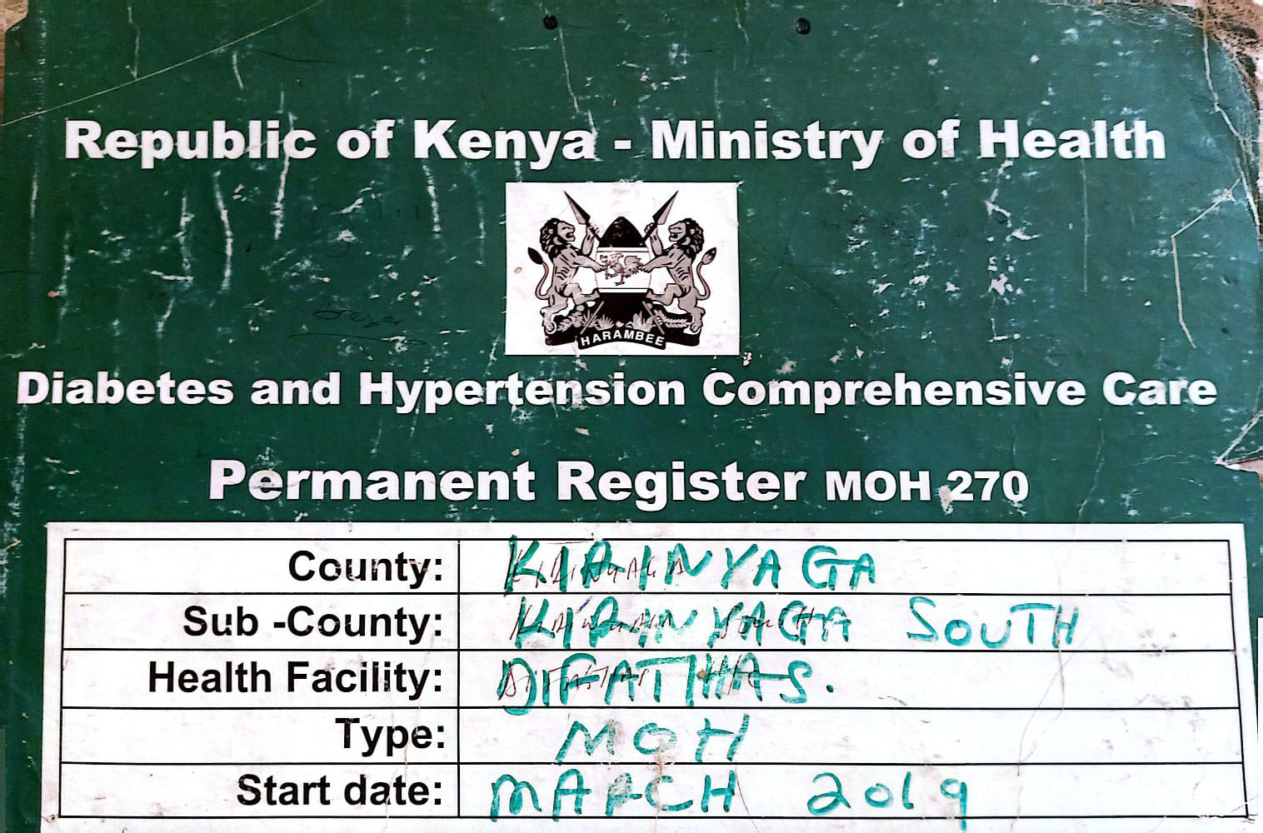
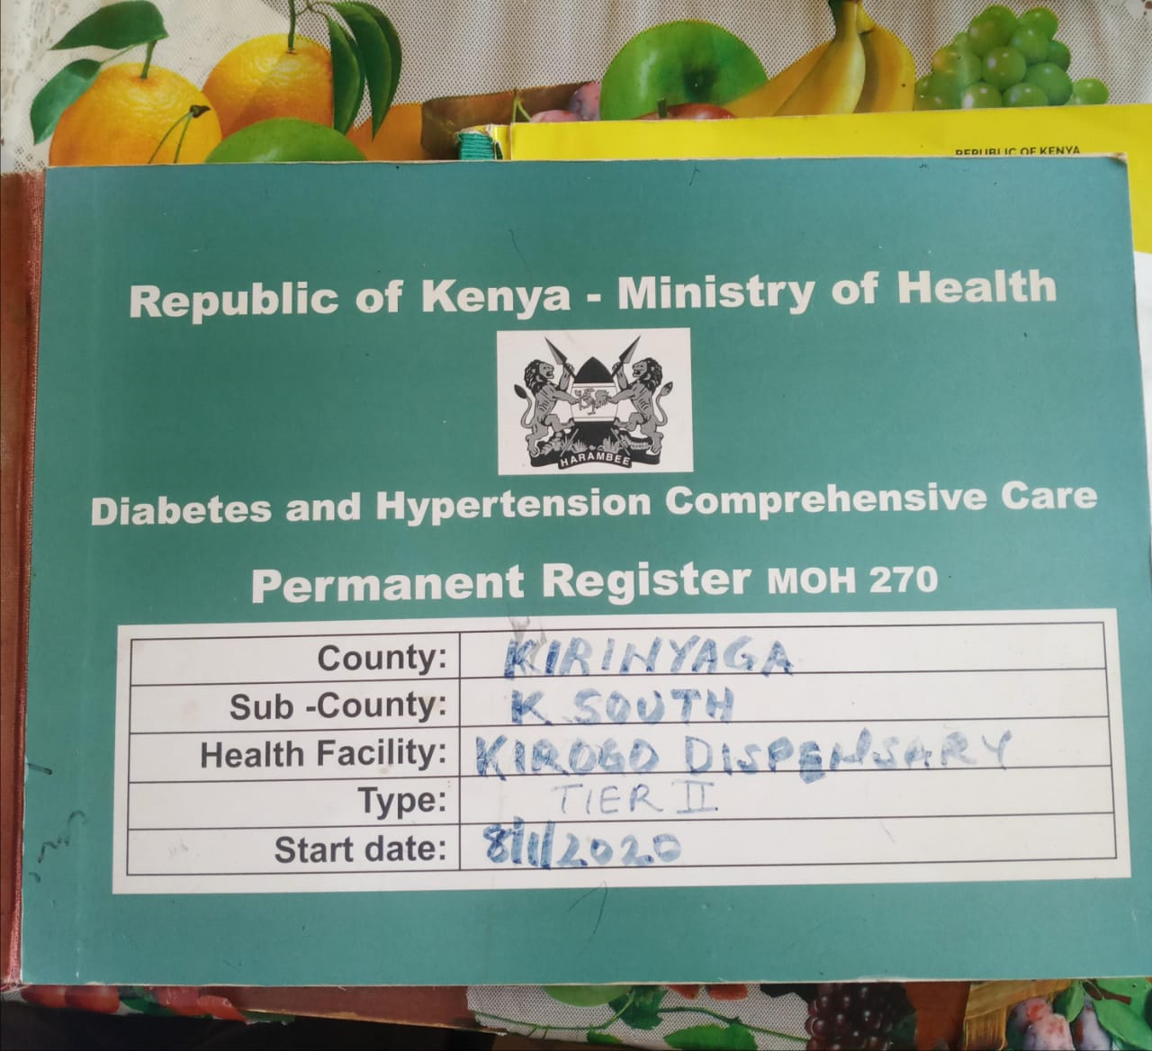
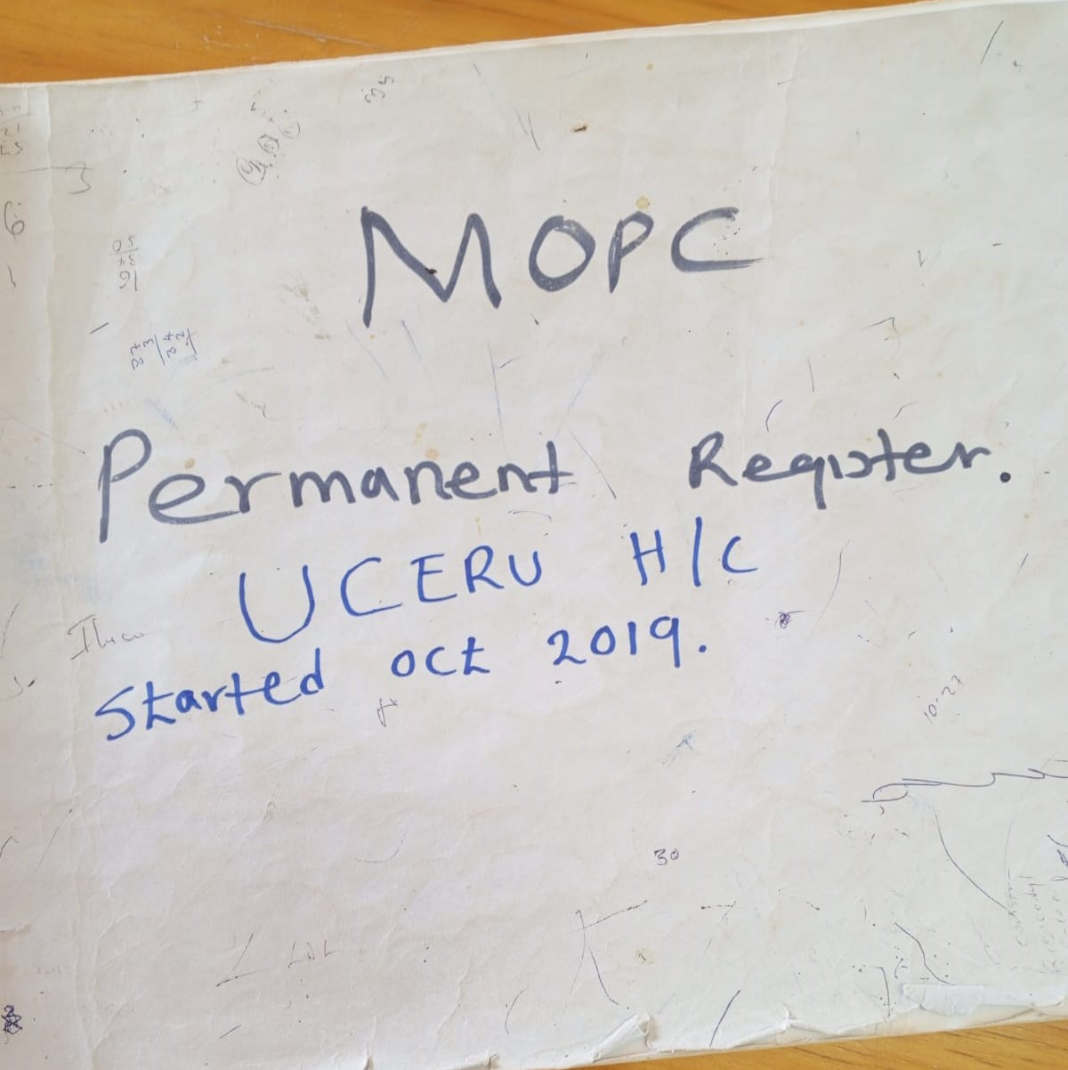
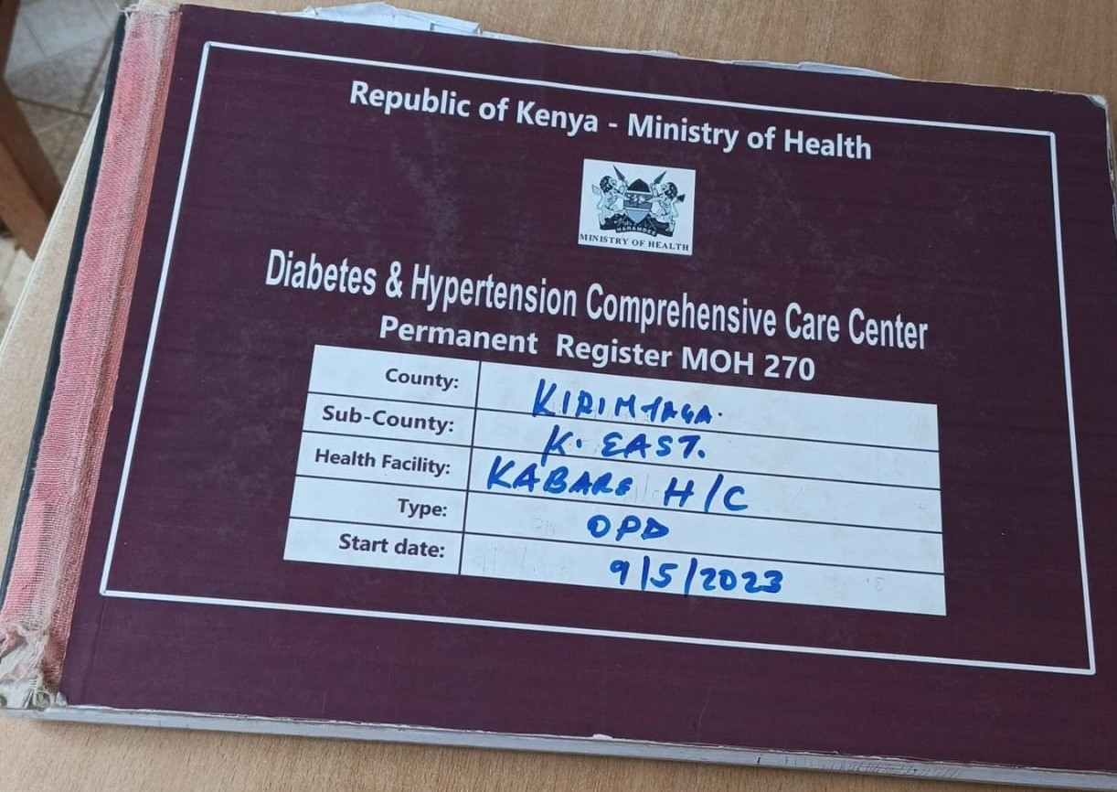
Pictorials

